Slide 1
Formulating research: Hypothesis
AEPSY Year 11 Psychology

Slide 2
Review
Explain the difference between full replacement and partial replacement with respect to animal ethics.
Explain the difference between informed consent and withdrawal rights with respect to human research.
What was the aim of Sperry’s Split Brain Experiment?

Slide 3
Learning Intentions
construct/formulate a hypothesis and/or inquiry question
directional and non-directional hypothesis (quantitative)
inquiry questions (qualitative)

Slide 4
Success Criteria
Define directional and non-directional hypotheses
Explain the difference between quantitative and qualitative studies/data
Write research questions and hypotheses for case studies

Slide 5
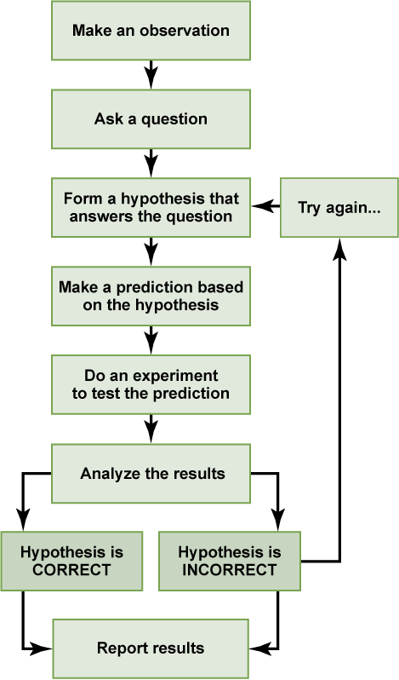
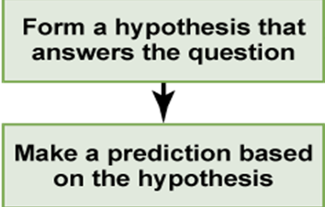
Scientific method

Slide 6
Directional hypothesis
states which way you think the results are going to go, for example in an experimental study we might say…”Participants who have been deprived of sleep for 24 hours will have more cold symptoms in the following week after exposure to a virus than participants who have not been sleep deprived”; the hypothesis compares the two groups/conditions and states which one will ….have more/less, be quicker/slower, etc.

Slide 7
Non-directional hypothesis:
States that there will be a difference between the two groups/conditions but does not say which will be greater/smaller, quicker/slower etc. Using our example above we would say “There will be a difference between the number of cold symptoms experienced in the following week after exposure to a virus for those participants who have been sleep deprived for 24 hours compared with those who have not been sleep deprived for 24 hours.”

Slide 8
Null hypothesis
States that the alternative or experimental hypothesis is NOT the case, if your experimental hypothesis was directional you would say…
Participants who have been deprived of sleep for 24 hours will NOT have more cold symptoms in the following week after exposure to a virus than participants who have not been sleep deprived and any difference that does arise will be due to chance alone.

Slide 9
Qualitative vs Quantitative
Quantitative data is numbers-based, countable, or measurable.
Qualitative data is interpretation-based, descriptive, and relating to language.

Slide 10


Slide 11
The Bystander Effect
Write an aim for this study
Write a hypothesis for this experiment
Is this quantitative or qualitative data?
Is this a directional or non-directional hypothesis?

Slide 12


Slide 13
The Asch Conformity Study
Write an aim for this study
Write a hypothesis for this experiment
Is this quantitative or qualitative data?
Is this a directional or non-directional hypothesis?

Slide 14
https://helpfulprofessor.com/psychology-experiments-and-case-studies/

Slide 15
Success Criteria
Define directional and non-directional hypotheses
Explain the difference between quantitative and qualitative studies/data
Write research questions and hypotheses for case studies

